Slide 1


Python Machine Learning
Žydrūnė Kelpšaitė
Data Analyst

Slide 2
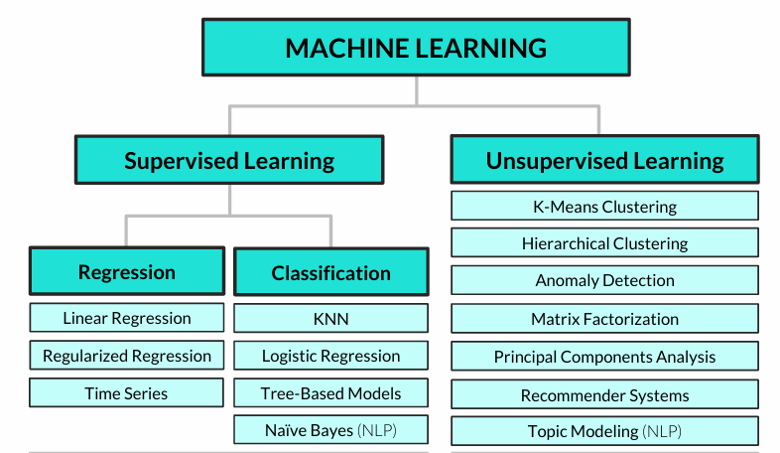
Common machine learning algorithms

Slide 3
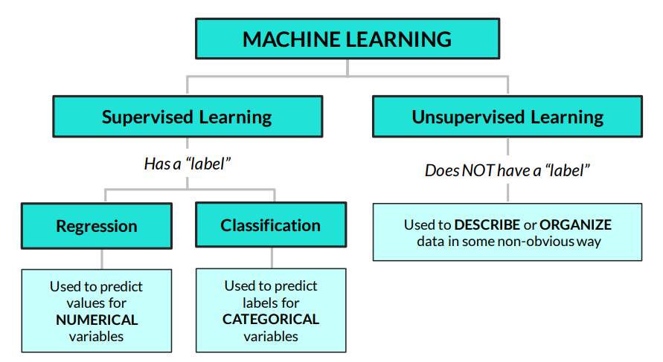
UNSUPERVISED LEARNING 101
Unsupervised learning is about finding insights & patterns hidden in the data
• Unlike regression or classification, we don’t care about splitting our data into train / test sets and making predictions, we just care about understanding the relationships in our data

Slide 4
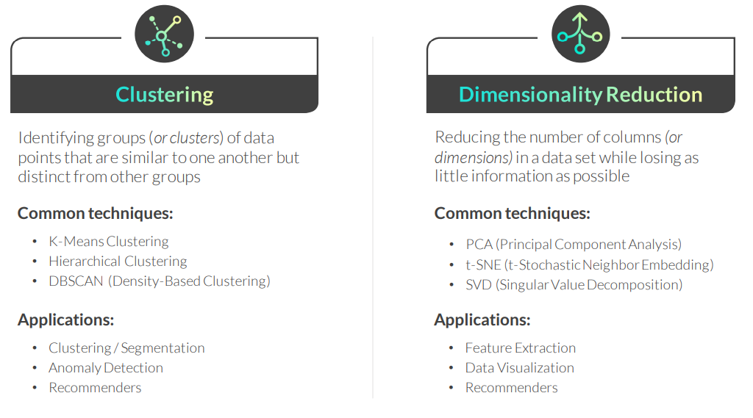
UNSUPERVISED LEARNING TECHNIQUES
There are two popular categories of unsupervised learning techniques:

Slide 5
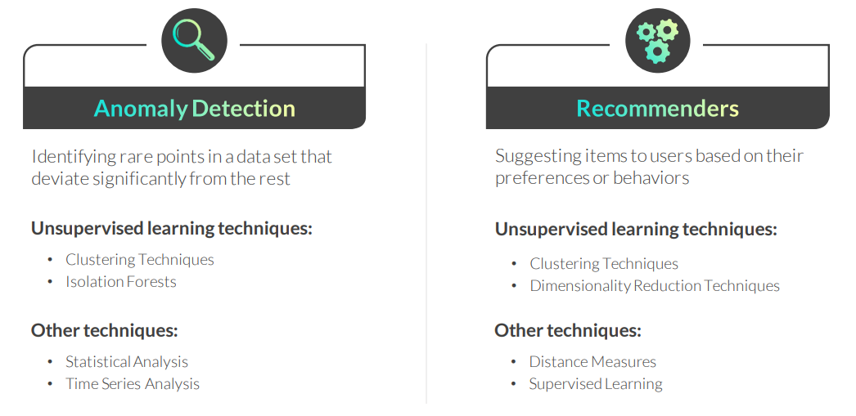
UNSUPERVISED LEARNING APPLICATIONS
These are two common applications of unsupervised learning techniques:

Slide 6
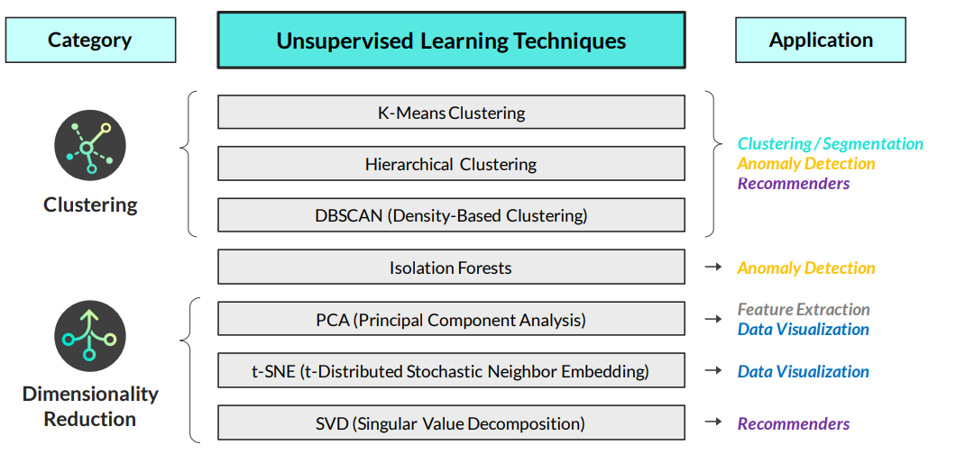
Unsupervised learning techniques & applications

Slide 7
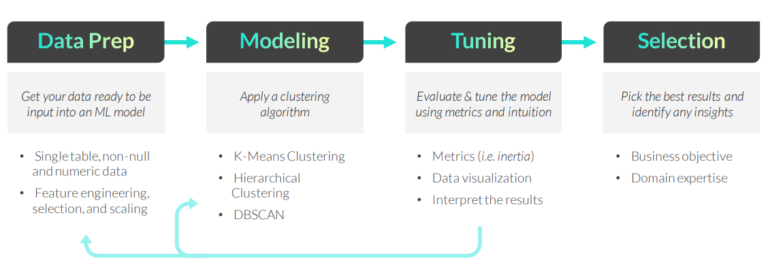
CLUSTERING WORKFLOW
The general clustering workflow consists of the following steps:
Remember, there’s no “right” answer or single optimization metric when it comes to clustering; the best outputs are the ones which help you answer the question at hand and make practical, data-driven business decisions

Slide 8
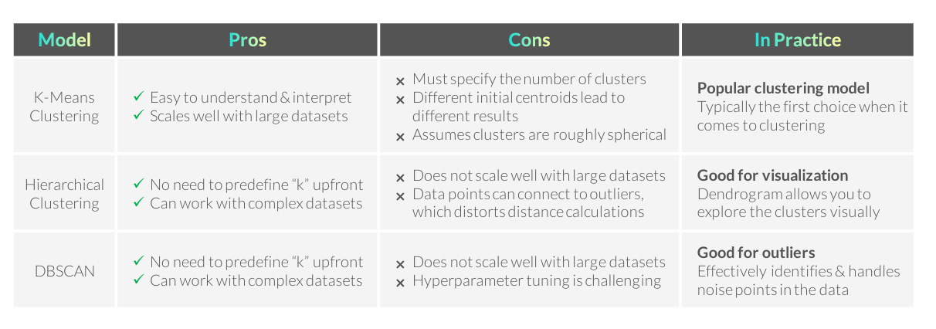
CLUSTERING ALGORITHMS RECAP

Slide 9
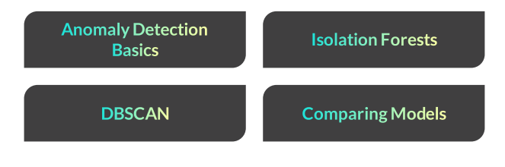
ANOMALY DETECTION

Slide 10
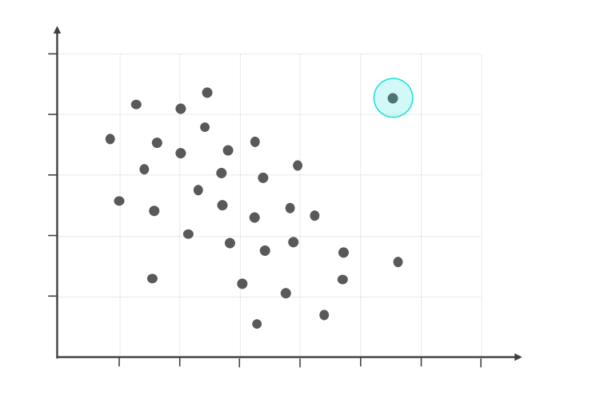
ANOMALY DETECTION BASICS
Anomaly detection, also known as outlier detection, is used to identify observations in a data set that are significantly different from the others

Slide 11
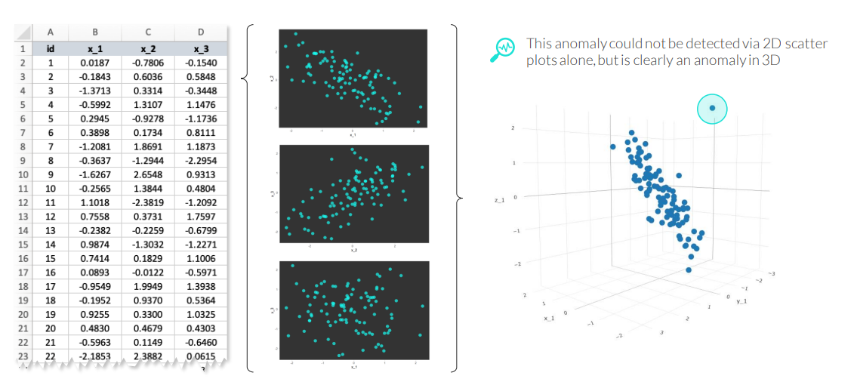
ANOMALY DETECTION BASICS
Anomaly detection, also known as outlier detection, is used to identify observations in a data set that are significantly different from the others

Slide 12
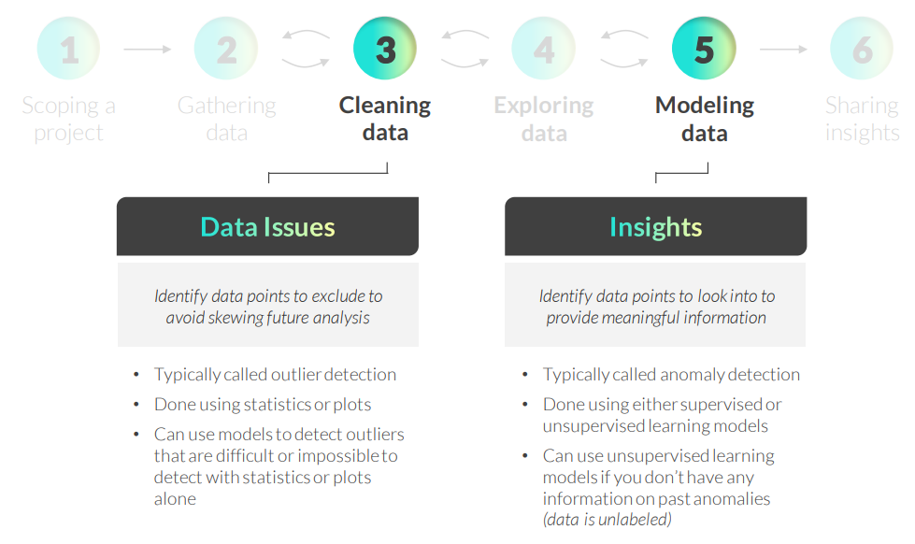
ANOMALY DETECTION IN THE DS WORKFLOW
Notes:
Popular approaches to anomaly detection include:
• Statistical analysis: flagging data points more than 3 standard deviations away from the mean
• Data visualization: visually identifying distant points by creating histograms, scatterplots, or boxplots
• Supervised learning: if you have information on past anomalies, you can apply classification algorithms like Random Forests to identify new ones
• Unsupervised learning: if you have unlabeled data, you need algorithms like Isolation Forests and DBSCAN

Slide 13
ANOMALY DETECTION APPROACHES
Popular approaches to anomaly detection include:
• Statistical analysis: flagging data points more than 3 standard deviations away from the mean
• Data visualization: visually identifying distant points by creating histograms, scatterplots, or boxplots
• Supervised learning: if you have information on past anomalies, you can apply classification algorithms like Random Forests to identify new ones
• Unsupervised learning: if you have unlabeled data, you need algorithms like Isolation Forests and DBSCAN
Many machine learning algorithms can be modified for anomaly detection including K-Nearest Neighbors, One-Class Support Vector Machines, Time Series Analysis, etc.

Slide 14
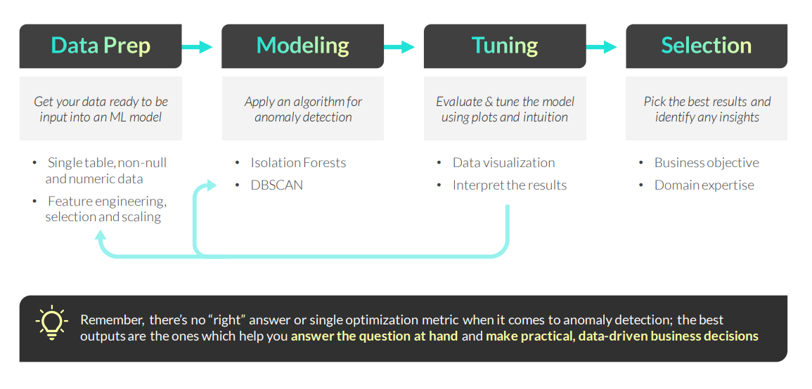
ANOMALY DETECTION WORKFLOW
The general anomaly detection workflow using unsupervised machine learning techniques consists of the following steps:

Slide 15
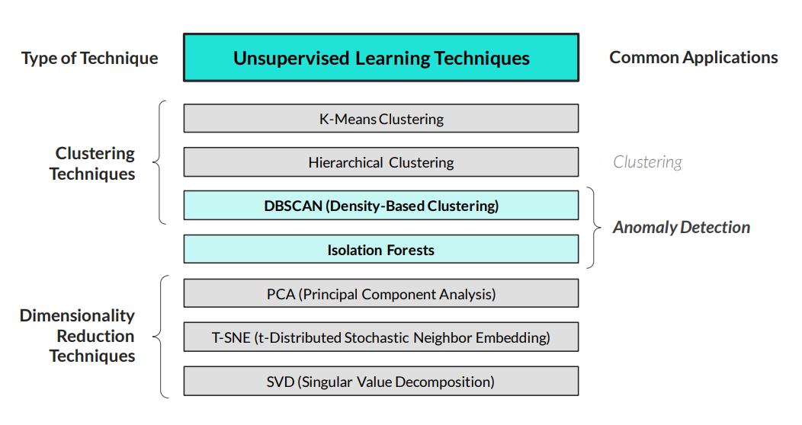
UNSUPERVISED LEARNING TECHNIQUES
You can perform anomaly detection using unsupervised learning techniques

Slide 16
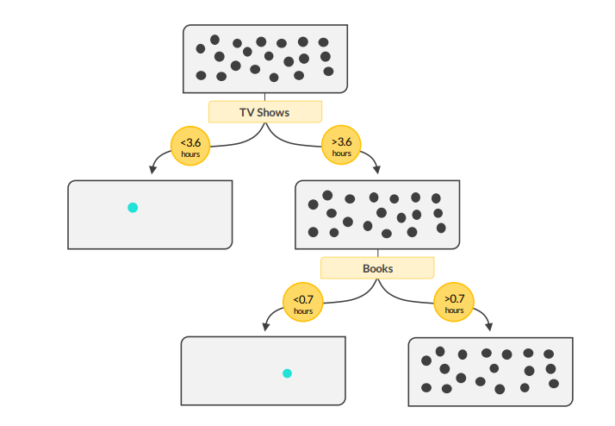
ISOLATION FORESTS
An Isolation Forest detects anomalies by building decision trees that split the data randomly and measure how quickly specific data points can be isolated

Slide 17
ISOLATION FORESTS
An Isolation Forest detects anomalies by building decision trees that split the data randomly and measure how quickly specific data points can be isolated
Here’s how it works: 1. Randomly select a feature from the data and split the observations using a random threshold
• If a value is under the threshold, it goes to one branch; otherwise, it goes to the other
2. Continue splitting the branches using random features and thresholds, creating a tree structure, until every data point is isolated or a maximum depth is reached
3. Repeat these steps using different features and splits to create multiple trees (aka a forest)
4. Calculate the anomaly score for each observation by averaging the number of splits it took to isolate (path length) in each tree – the lowest scores are anomalies!
Example use cases:
• Detect fraudulent activities in financial data or credit card transactions
• Detect unexpected malfunctions in sensor data or unusual test results in patient data

Slide 18
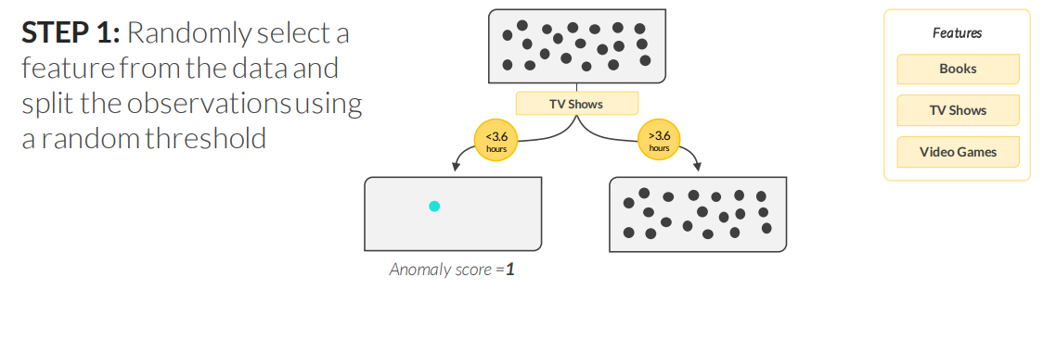
ISOLATION FORESTS

Slide 19
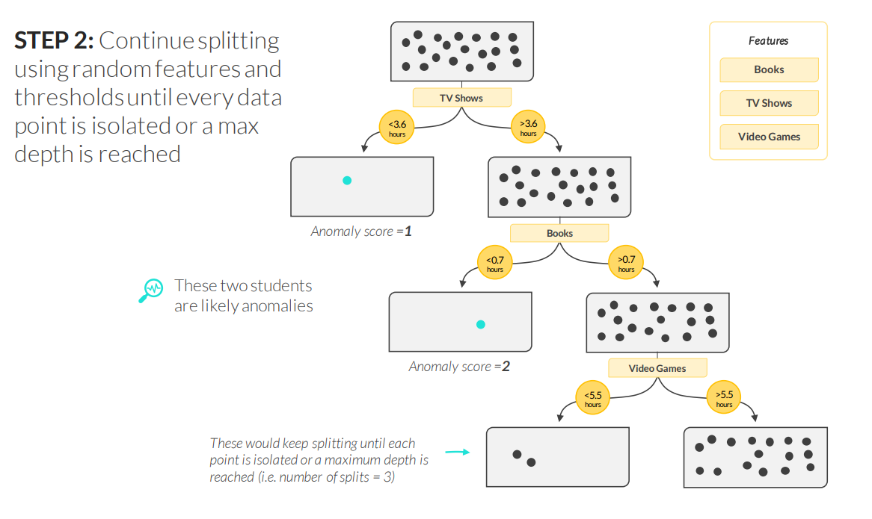
ISOLATION FORESTS

Slide 20
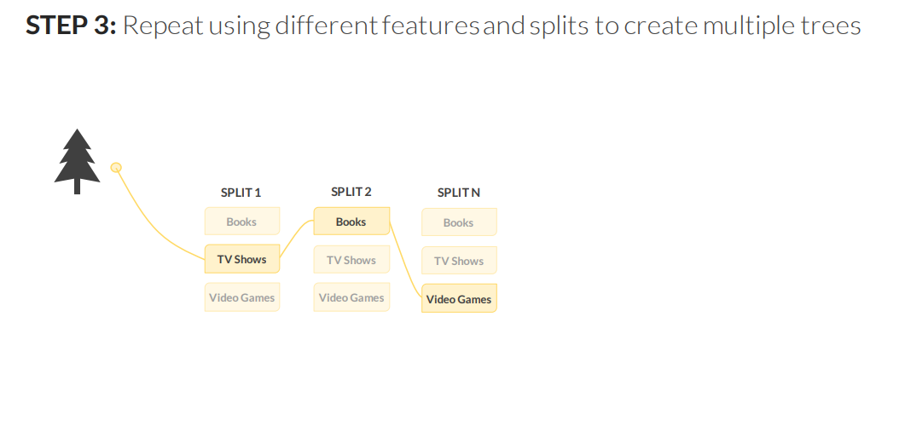
ISOLATION FORESTS

Slide 21
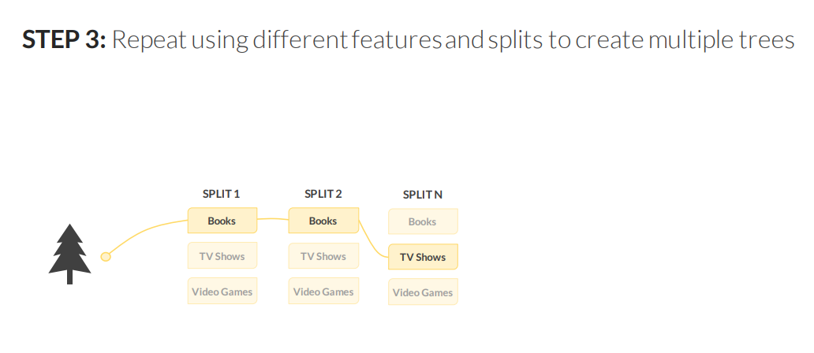
ISOLATION FORESTS

Slide 22
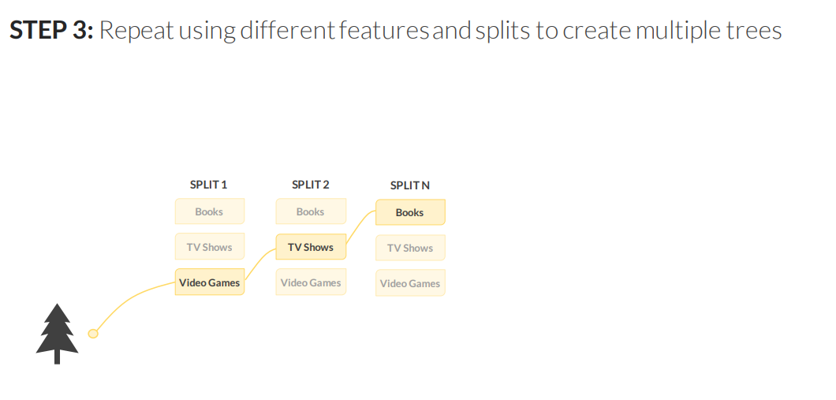
ISOLATION FORESTS

Slide 23
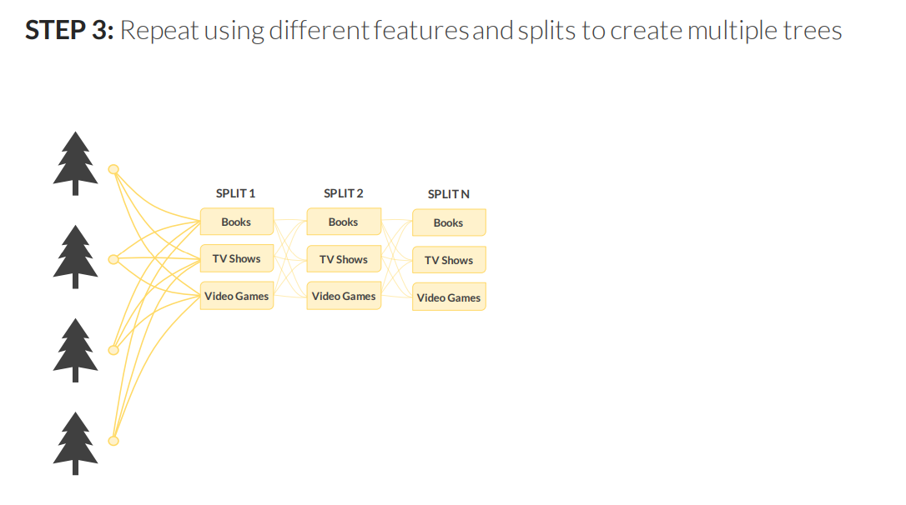
ISOLATION FORESTS

Slide 24
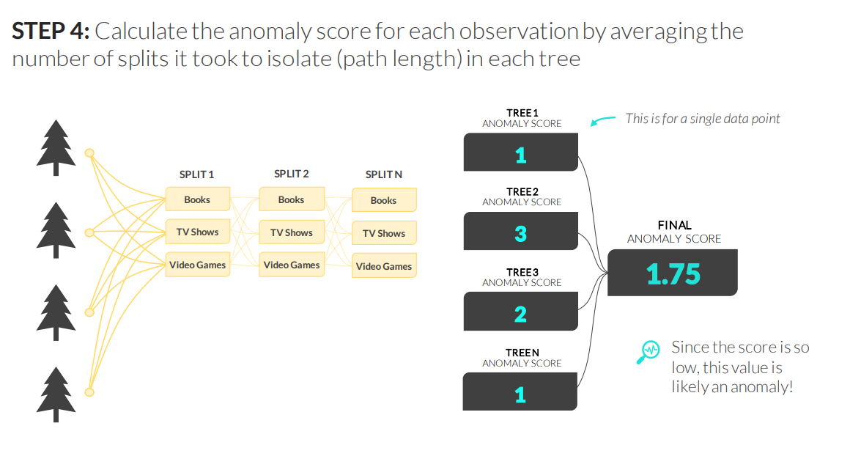
ISOLATION FORESTS

Slide 25
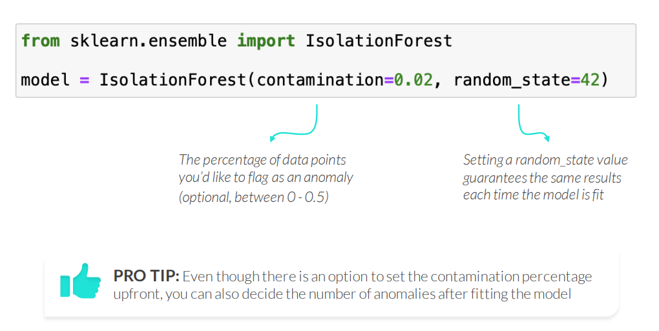
ISOLATION FORESTS IN PYTHON
Use sklearn’s IsolationForest() to apply Isolation Forests in Python

Slide 26
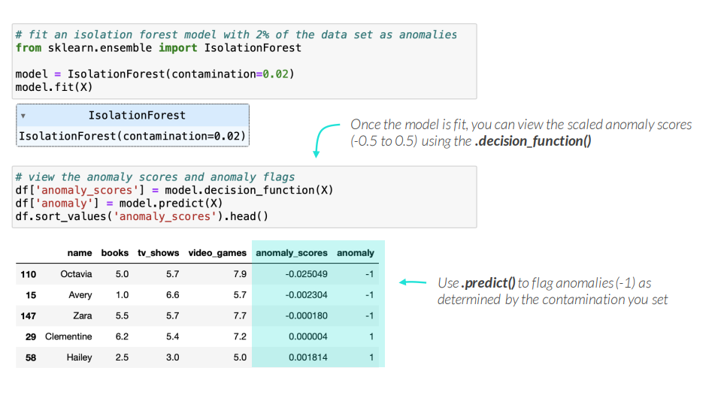
ISOLATION FORESTS IN PYTHON
Use sklearn’s IsolationForest() to apply Isolation Forests in Python

Slide 27
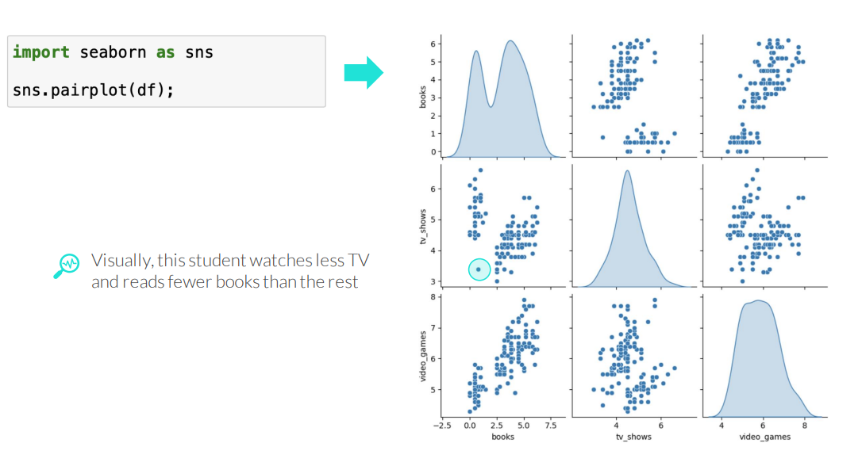
VISUALIZING ANOMALIES
Visualize anomalies by using the anomaly flags as the “hue” in a pair plot

Slide 28
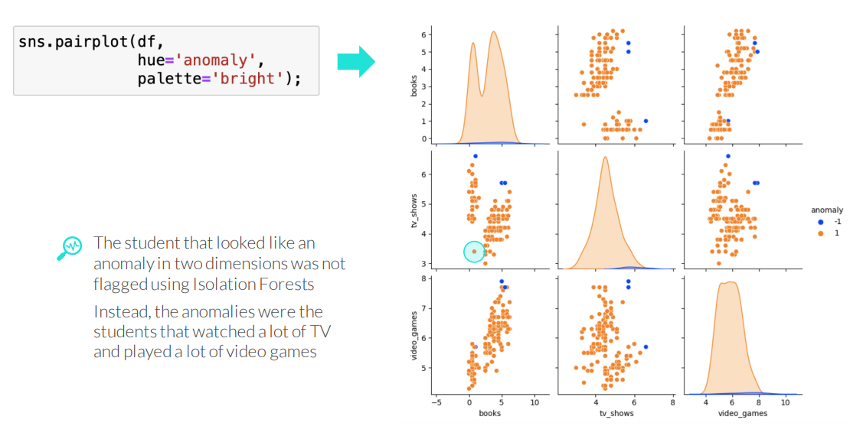
VISUALIZING ANOMALIES
Visualize anomalies by using the anomaly flags as the “hue” in a pair plot

Slide 29
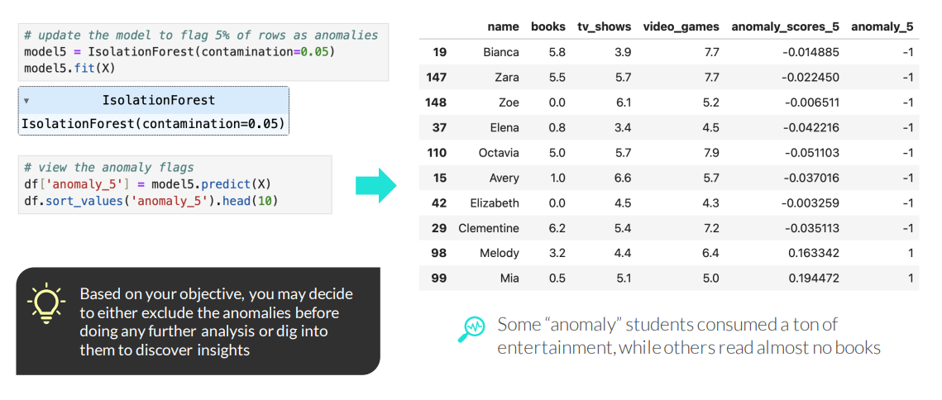
TUNING & INTERPRETING ISOLATION FORESTS
After you view the results of your first Isolation Forest model, you can:
• Tune the model by updating the contamination percent to flag more or fewer anomalies
• Interpret the results by filtering on the anomaly labels or sorting the anomaly scores

Slide 30
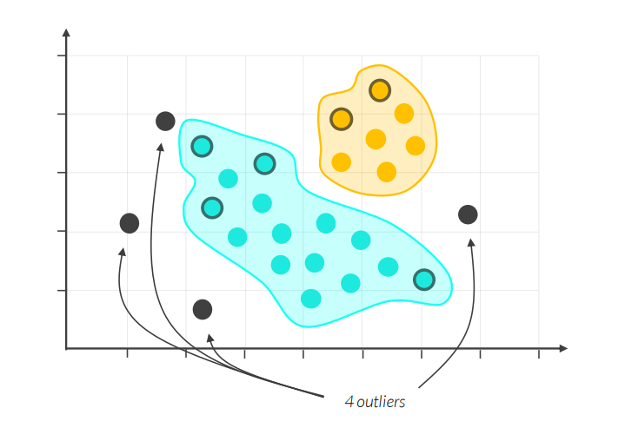
DBSCAN FOR ANOMALY DETECTION
DBSCAN (Density-Based Spatial Clustering of Applications with Noise), which is a clustering technique, can also be used for anomaly detection

Slide 31
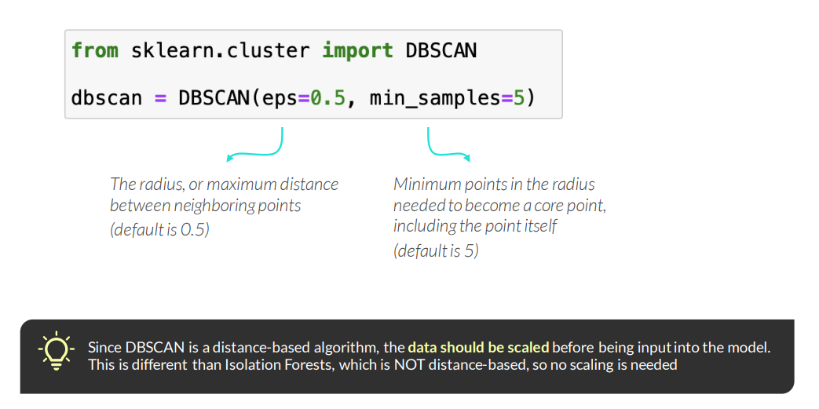
DBSCAN FOR ANOMALY DETECTION IN PYTHON
Use sklearn’s DBSCAN() to apply the DBSCAN algorithm in Python

Slide 32
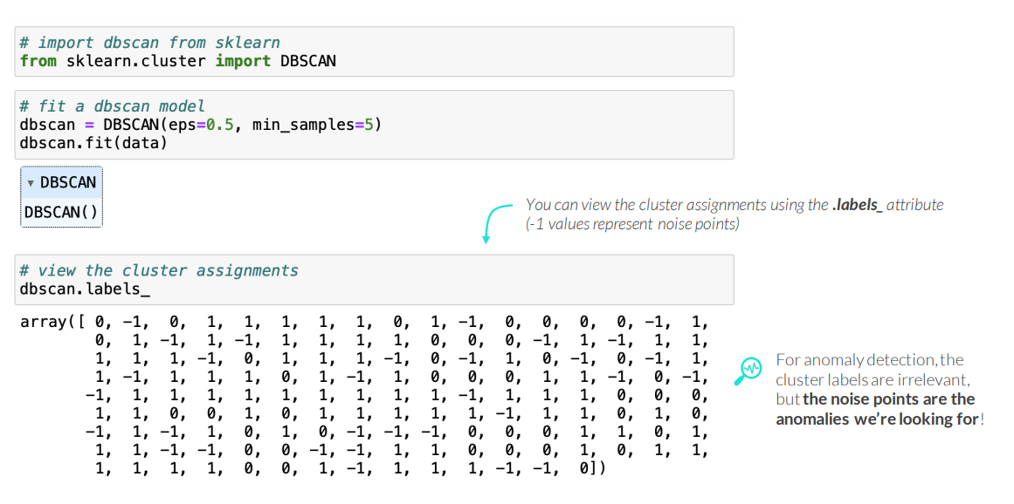
DBSCAN FOR ANOMALY DETECTION IN PYTHON
Use sklearn’s DBSCAN() to apply the DBSCAN algorithm in Python

Slide 33
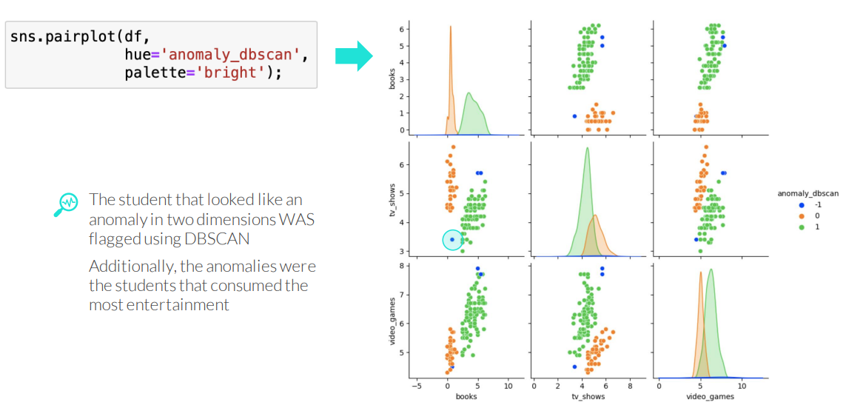
VISUALIZING DBSCAN ANOMALIES
Visualize anomalies by using the anomaly labels as the “hue” in a pair plot

Slide 34
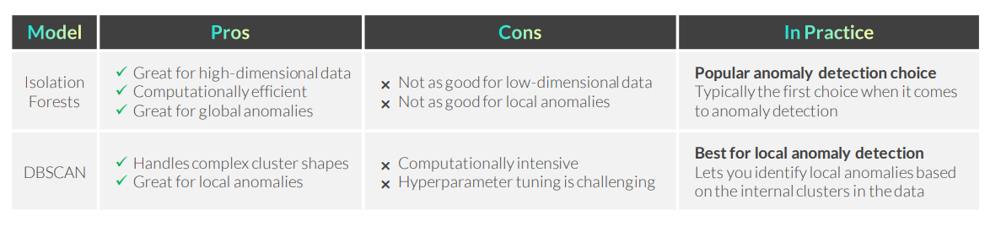
RECAP: ANOMALY DETECTION

Slide 35
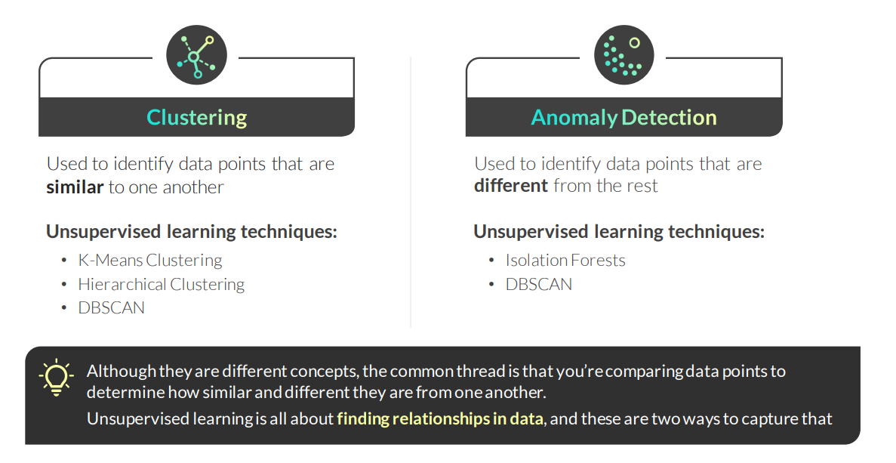
RECAP:CLUSTERING & ANOMALY DETECTION

Slide 36
KEY TAKEAWAYS
Anomaly detection aims to find observations different than the rest
• Common unsupervised techniques for anomaly detection are Isolation Forests and DBSCAN
• There are other ways to detect anomalies, including statistics, data visualization, and supervised learning
For unsupervised learning, follow the anomaly detection workflow
1) Prep your data for anomaly detection (scaling is not required for Isolation Forests, but it is for DBSCAN)
2) Start with Isolation Forests, then visualize, tune, and select a model
3) Try DBSCAN for different results, then visualize, tune and select a model
4) Compare the anomalies from all the models using data visualization, exploratory analysis, and your intuition
5) Select the model that best addresses your business question
6) You can choose to further explore or exclude anomalies detected by one or more models

